Slide 1
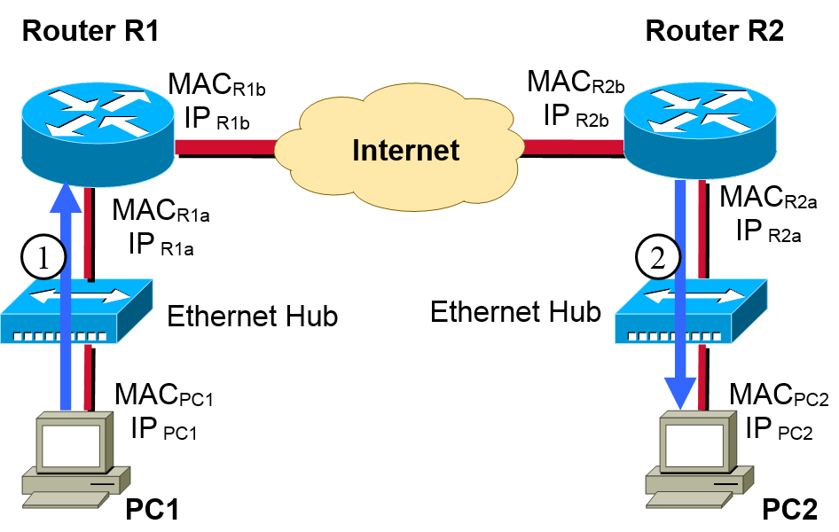
IP
IP
Net. Access
Net. Access
Net. Access
Net. Access
Physical
Physical
Physical
Physical
Application
Application
TCP/UDP
TCP/UDP
IP
IP
Net. Access
Net. Access
Physical
Physical

Slide 2
Application layer: FTP, TELNET, SMTP, SNMP, HTTP
Routing Protocol: BGP, OSPF, RIP -> Multicast
Transport layer: TCP, UDP, SCTP
IP, ICMP, IGMP, RSVP (QoS)
ARP, DHCP
PC4
PC3
Router R3
Routing Protocol
L2 Switch
Router R1
ARP: IP->MAC addr
X.25
ATM
Router R2
Ethernet Hub
Ethernet Hub
Bridge
PC2
IPsrc
IPdst
Upper layer
PC1
DHCP
DHCP Server
MACsrc
MACdst
IP Packet
subnet
(IP addr. bitwise-AND SubnetMask)

Slide 3
Interconnected Device
Ethernet Hub
L1, Repeater
Collision Domain
PC1
PC2
PC3
PC4
PC1
PC4
PC2
PC3
Subnet
Broadcast Domain
Collision Domain
Collision Domain
PC1
PC3
L2 Device
Bridge
L2 Switch
PC2
PC4
Collision Domain
Collision Domain
Subnet
Subnet
L3 Device
Router R1
Subnet
Subnet
All-layer Device
Firewall

